Slide 1
Progrexion RentTrack BuildCreditModule

Slide 2
Build Credit Module
WEB Module
BCM Module Design
Customer Controller
Lease Controller
Plaid Controller
DTO
Actuator End point (Health Check)
Transaction Controller
Payment Controller
Common Packages (enum, models, exception, etc.)
Rent Track API
Service Module
Plaid Service
Transaction Service
Customer Service
Lease Service
Payment Service
Adapter/Proxy
AWS
API Model
Rent Track Adapter
Active MQ Adapter
Active MQ
Service Model
Amazon RDS
Data Module
Entities / Model
JPA Repositories

Slide 3
BCM Oauth High Level Design
BCM Services App
Client
AWS RDS
Authorization Req
Resource Owner
Authorization Server
/oauth/token ; client:clientsecret,
grant_type=password, username=<>, password=<>
Read/write: Client_details, Users, Tokens
Access Token (jwt)
{… “access_token”: “….” }
BuildCredit
Request Resource
Resource Server
/<bcm-api> ; Authorization = Bearer <access_token>
Resource
{… <bcm-api-response> …}
Read/write: Resources/Entities

Slide 4
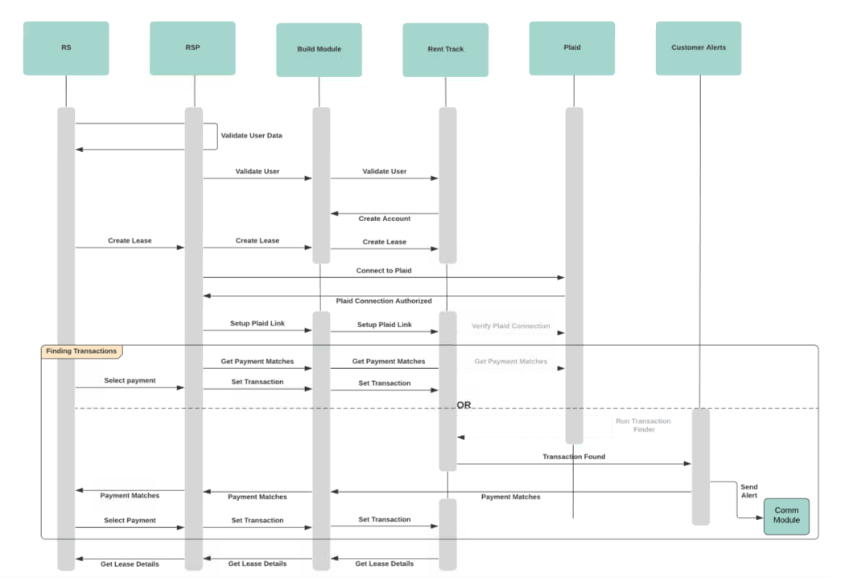
BCM Sequence Flow

Slide 5
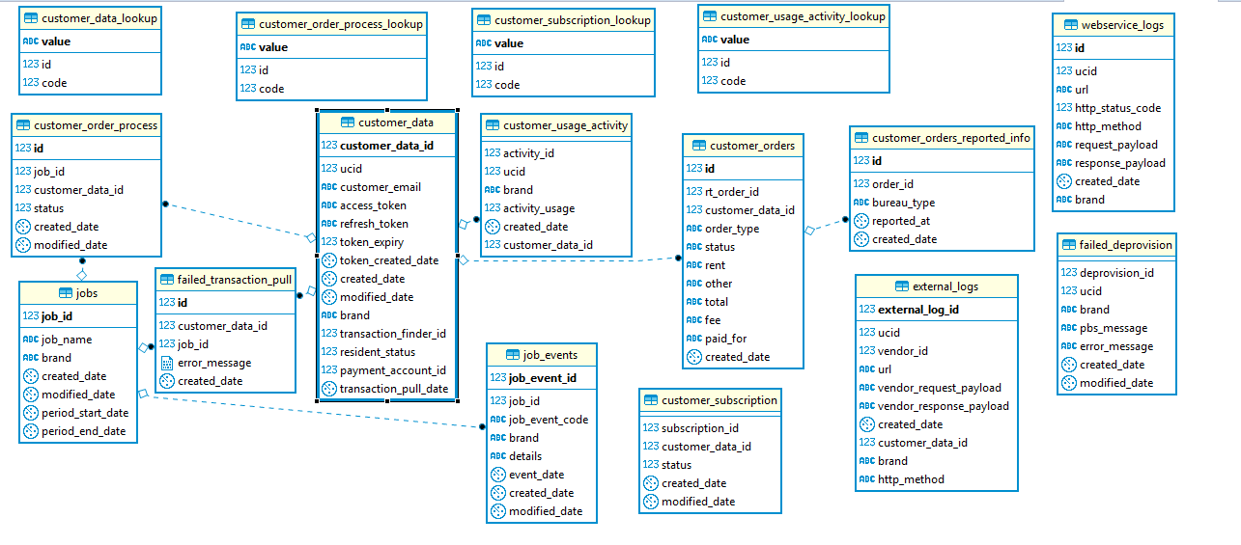
BCM ER Diagram – Part 1

Slide 6
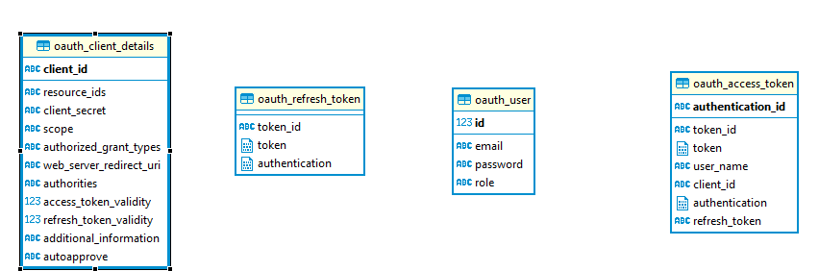
BCM ER Diagram – Part 2

Slide 7
Heroku Deployment Steps
Step No. | Commands
1 | git clone https://github.com/progrexion/extracredit-bcm-services.git
2 | cd extracredit-bcm-services git checkout <Branch name>
3 | heroku login
4 | heroku container:login
5 | heroku apps:create extracredit-bcm-dev -t progrexion --space=pgx-extracredit-bcm
6 | heroku container:push web -a extracredit-bcm-dev
7 | heroku container:release web -a extracredit-bcm-dev

Slide 8
References
Reference | URL
Apiary Link | https://buildcreditmodule.docs.apiary.io/# https://gitlab.pgx.local/common/pgx-apiary/tree/extrac-credit-bcm/extracreditbcm
Github (BCM CodeBase) | https://github.com/progrexion/extracredit-bcm-services/
BCM Deployment | https://extracredit-bcm-dev.herokuapp.com/buildcredit/ https://extracredit-bcm-test.herokuapp.com/buildcredit/ https://extracredit-bcm-stage.herokuapp.com/buildcredit/

Slide 9
Thank you

